Slide 1


Slide 2
Application state
A typical JavaScript application is full of state. Here are some examples:
what the user sees (data)
what data are we fetching
what URL are we showing to the user
what items are selected inside the page
are there errors in the applications? That’s state too
Notes:
State is everywhere in JavaScript. But can you imagine how much state a React application has?
Yeah, you can get by with keeping the state within a parent React component as long as the application remains small.
Then things will become tricky especially when you add more behaviors to the app.
At some point we may want to reach for a consistent way for keeping track of state changes.

Slide 3
What problem does Redux solve?
Redux is a JavaScript library that allow you to manage application state
Redux solves a problem of giving each React component the exact piece of state it needs.
Redux holds up the state within a single location - Store.

Slide 4
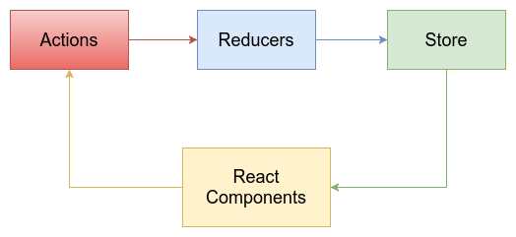
Redux flow
Notes:
Redux architecture revolves around a strict unidirectional data flow.
This means that all data in an application follows the same lifecycle pattern, making the logic of your app more predictable and easier to understand. It also encourages data normalization, so that you don't end up with multiple, independent copies of the same data that are unaware of one another.

Slide 5
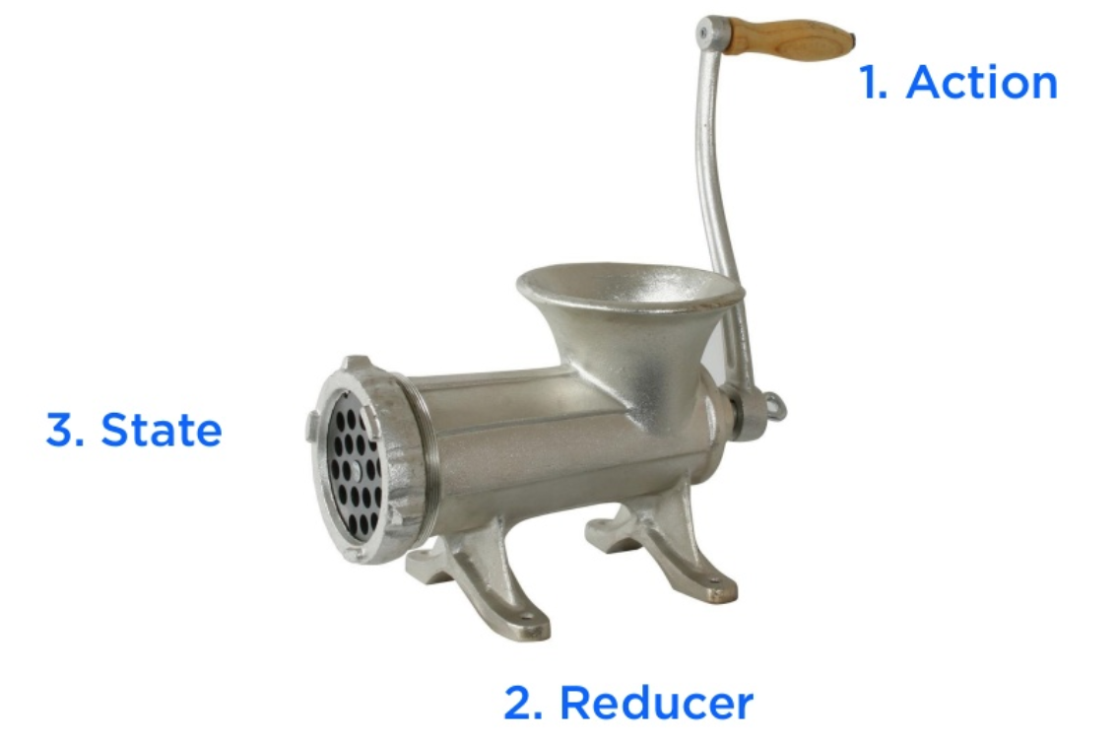
Basic concept

Slide 6
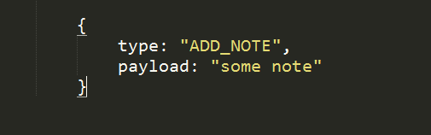
Action
Action is a pure object that represents a minimum data which describes a change
Only “type” property is required

Slide 7
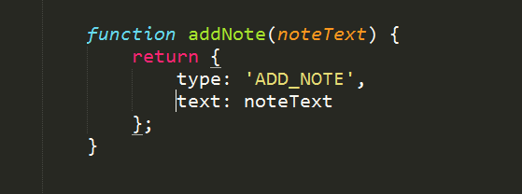
Action Creators
Pure function which creates an action
Make it easier to create an action
Reusable, Portable, and Easy to Test

Slide 8
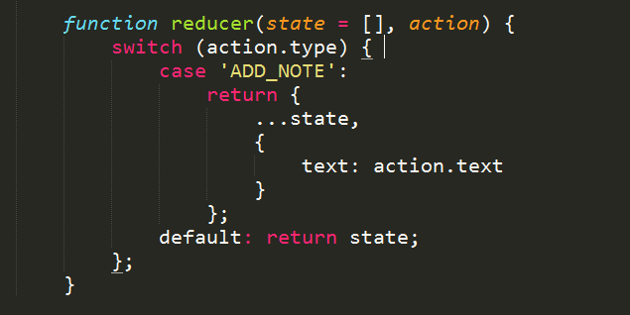
Reducer
Reducer Pure function which returns the next state
reducer(previousState, action) => state

Slide 9
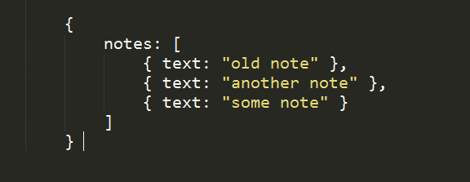
Store
A plain object which holds application state
Store is the only state for the whole app
Dispatching actions is the only way to update store

Slide 10
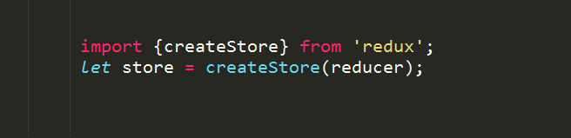
Store Creation
with Reducer (the spec of your store)

Slide 11

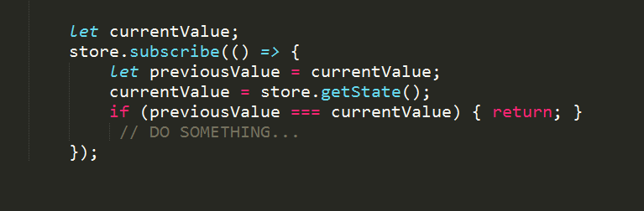
Store APIs
store - dispatch
store - subscribe store - getState

Slide 12
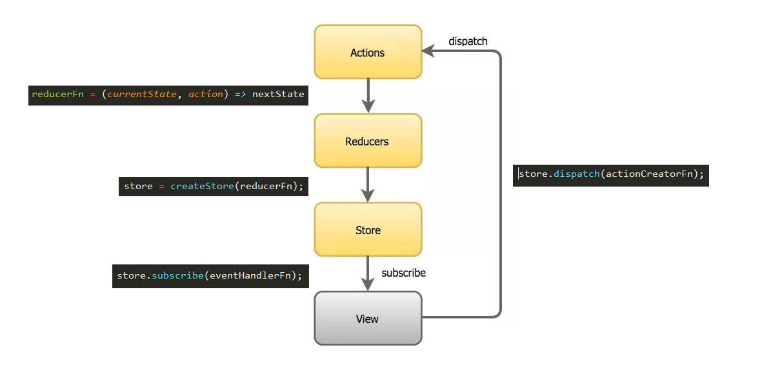
Application data flow

Slide 13
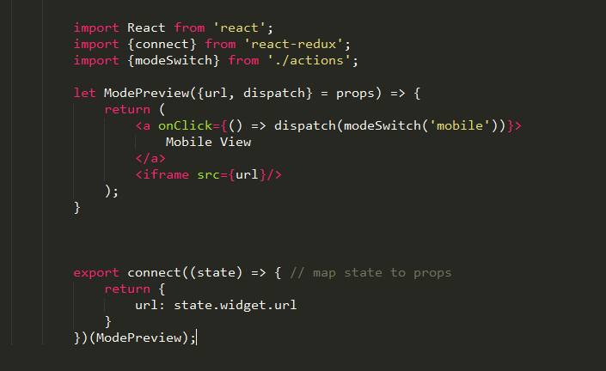
React + Redux example
Notes:
Describe a code

Slide 14
"A predictable state container"
Single source of truth
Consistent and portable
Separate presentation layer from logic and data
You can specify the behavior of your app before even starting to write the UI.
Scalable
Complexity through composition
Summary
Redux offers:
A predictable state container
Single source of truth
Consistent and portable
Separate presentation layer from logic and data
You can specify the behavior of your app before even starting to write the UI.
Scalable
Complexity through composition

